Slide 1
How to Throw a Party
Joe LaBracio
Notes:
What I’m hear to talk to you guys about today is how to throw a party.

Slide 2
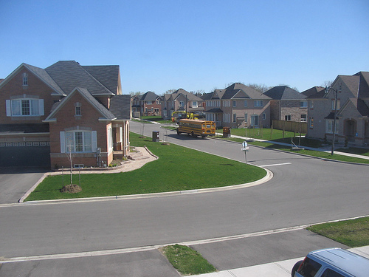
Where is the party
Location of the party is very important
Nobody wants to get lost in the middle of nowhere
Easy to get to places
Suburban locations
Notes:
First of all, location is key. No one wants to drive 3 hours away and get lost in the middle of the desert. If that’s the case… give directions! It would be nice to have a party in a easy to find, recognizable location. Such as suburban neighborhoods. Granted it doesn’t turn into project X.

Slide 3
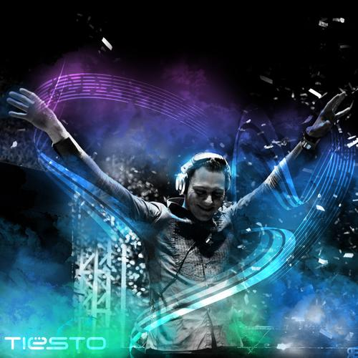
Music
This is a necessity
Music sets the tone of the night
Bad music? Bad party
Type of music
Based of guests attending the party
Notes:
This is a necessity, for a good party music of any kind should be there. Depending on the type of guests you have, that’s how you should pick your type of music. For instance, you wouldn’t want to play classic music at a party of all teenagers. And the same goes for adults. It would be ill advised to start bumpin’ rap music for a group of middle aged people.

Slide 4
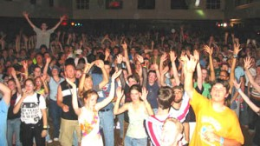
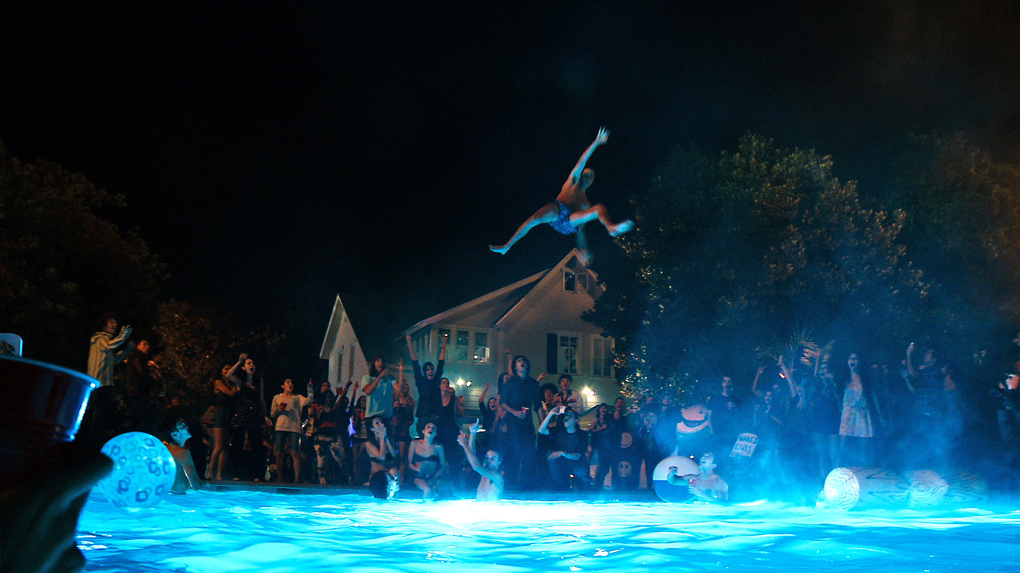
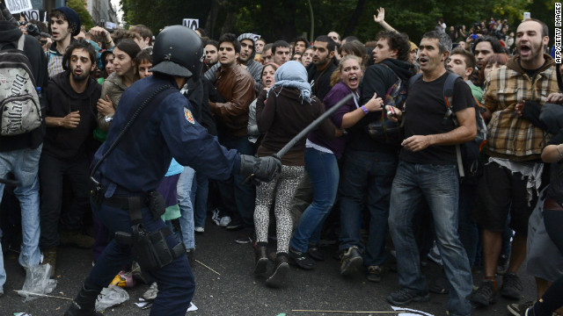
People attending the party
Young kids?
Obnoxious
Loud & annoying
Prone to breaking things
Notes:
Which brings me to my next point, If the party guests are teenagers, well, you’ve got yourself a problem. Teen parties are known to be loud, obnoxious, and prone to breaking things and causing havoc. Have you even seen the movie project x?

Slide 5
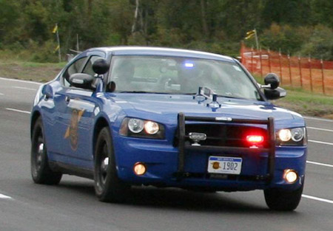
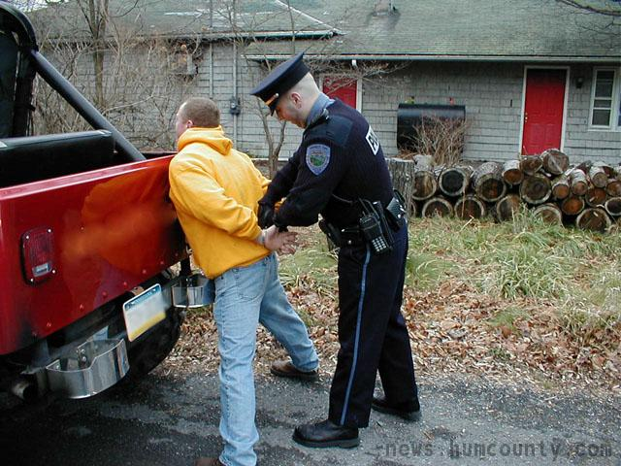
Alcohol
This is for people of age!
Can get rowdy
Make sure it’s contained
Notes:
Now before I say anything just remember you must be 21+ to consume alcohol. From stories I’ve heard of these kinds of parties things seem to get out of control rather quickly. Demonstrated in the Movie Project X. This was a party of teenagers drinking and just so happened to destroy a whole town. Even when your of age, it is important to keep the party controlled

Slide 6
Most Important Part!
Have a party with Xanadu!
Notes:
The most important part of having a party… is planning it with Xanadu. Because nobody else can plan a party better than us.

